Slide 1

MicroControllers
Lecture 21 – Bluetooth
Spring 2020

Slide 2
Today’s Lecture
Bluetooth Communication Introduction
Bluetooth Libraries
HW#9 Due Today
Assignment

Slide 3
BlueTooth communication Intro

Slide 4
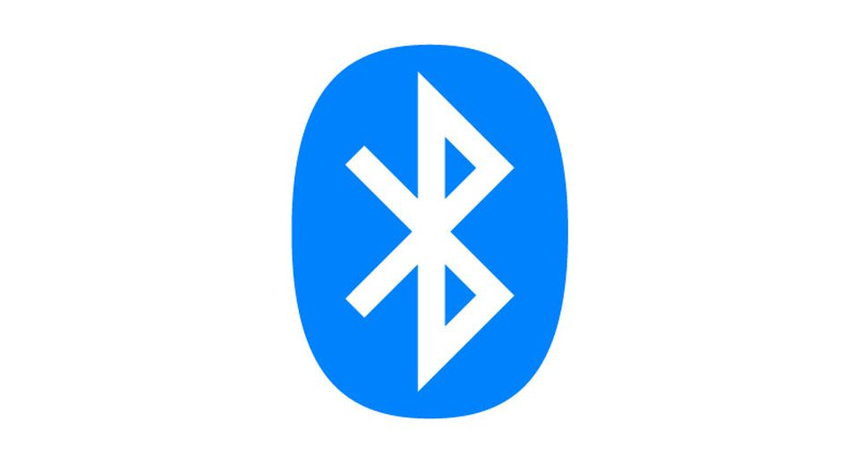

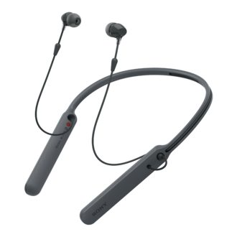
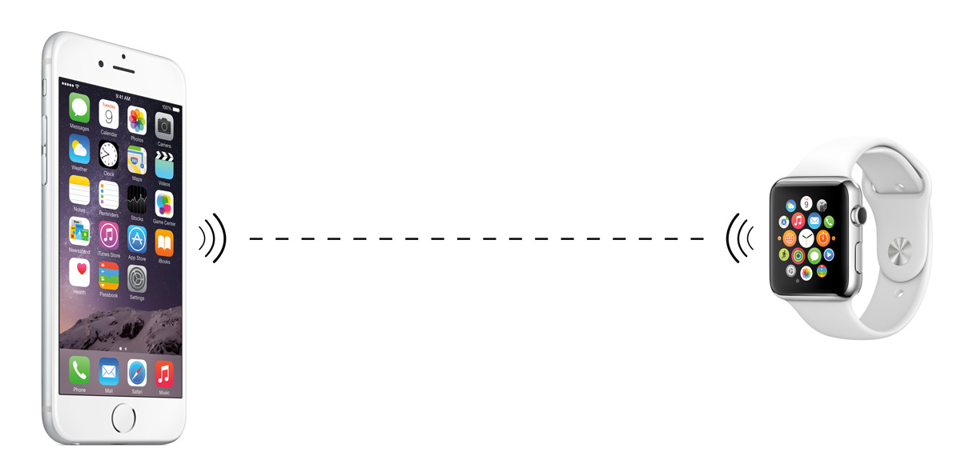
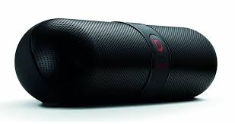
What is Bluetooth?
Bluetooth is a wireless communication protocol
Low power: 10 mA in standby, 50 mA while transmitting
Low-cost: $5 per device
Small: 9 mm² single chips

Slide 5
Limitations of Bluetooth
Bluetooth technology is prevalent, but limitations have prevented it from becoming the de-facto wireless technology
Short communication range
Most Bluetooth devices are Class 2 which have a range of about 10 meters (30 feet)
The more objects that are in between devices, the less range it will have
Slow transfer rate
About 3 Mbits per second (compare to wifi which is 54 Mbps)

Slide 6
Communication Model
Bluetooth is based on a master-peripheral model
Up to seven active peripherals can be connected to form a local network (called a piconet)
There may be other inactive or parked peripheral devices in the piconet. Up to 255 parked devices are allowed
Piconet
Collection of devices connected in an ad hoc fashion
Master-peripheral relationship is constant for the lifetime of the piconet
Master determines hopping pattern (more to come), peripherals have to synchronize

Slide 7
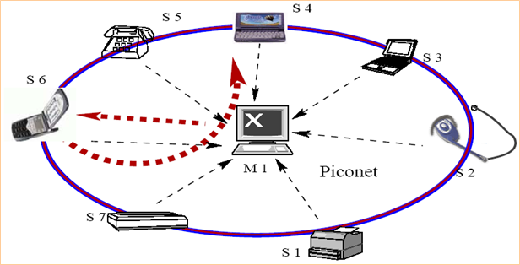
Piconet
P5
P4
P3
P6
P2
P7
P1

Slide 8
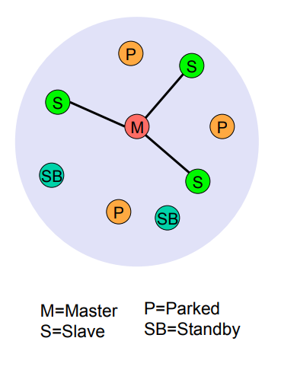
Piconet
M = Master
S = Peripheral Device
SB = Standby
P = Parked

Slide 9
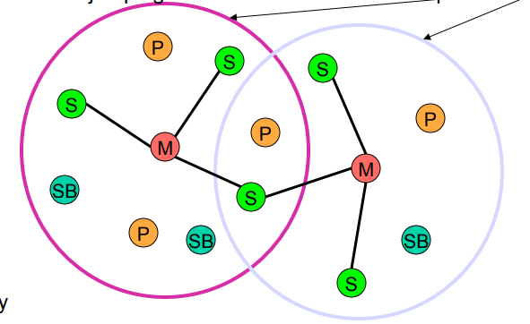
Scatternet
Linking of multiple co-located piconets through the sharing of common master or peripheral devices
Device can be peripheral in one piconet and master of another
Piconets
M = Master
S = Peripheral Device
SB = Standby
P = Parked

Slide 10
Communication
Bluetooth uses a technique of time division duplex (TDD) to coordinate the access to the physical channel
Time is divided into fixed length intervals (625 microseconds) called slots
Each second is divided into 1,600 slots
Master sets the ratio frequency and initiates a data communication

Slide 11
Frequency Hopping
The master sets the frequency hopping sequence
The 2.4 GHz band is divided into 79 channels with their frequencies 1 MHz apart
In each slot both the master and the peripheral device switch to a different channel
Hopping is done 1,600 times per second
Technique is called FHSS (frequency hopping spread spectrum)
The peripheral devices follow the hopping sequence set by the master using a special algorithm

Slide 12
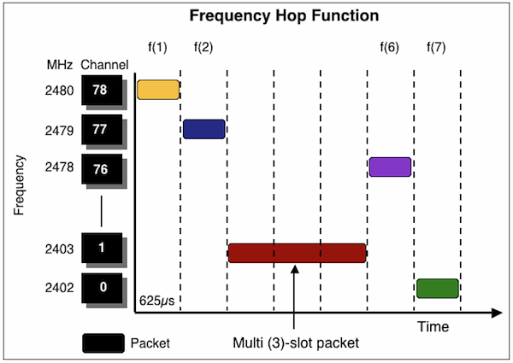
Frequency Hopping
The original signal is spread out among 79 1MHz bands
Packets may be 1, 3 or 5 slots long
Master transmit begins in even number slots
Peripheral transmit in odd number slots

Slide 13
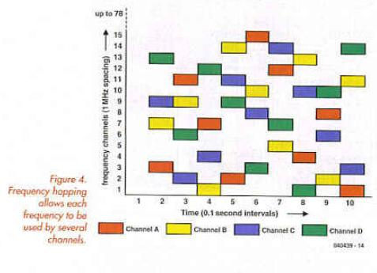
Frequency Hopping
Several Bluetooth nodes can share the same frequency band using different frequency-hopping sequences

Slide 14
Slots
The master initiates communication
Master transmits data to a peripheral device in even numbered slots
Master receives data from peripheral device in odd numbered slots
A peripheral device is only allowed to transmit data in a slot if the master has polled it or sent a data packet to it in a preceding slot
The peripheral responds to the master by sending a data packet or a NULL packet if the peripheral has nothing to send

Slide 15
Addresses
Each Bluetooth device has a unique fixed 48-bit address
Assigned at the time the device is manufactured
Two communicating devices need to know each other’s address
Software programs can specify the address if programmers know it
The address can also be discovered during the device discovery process
The discovery process searches all devices nearby and identifies the one that matches a user-friendly name such as “Joe’s Phone”

Slide 16
Transfer Protocols
Many transfer protocols are available between two Bluetooth devices
A standardized set of protocols designed for a particular type of device is termed as a Bluetooth device profile
Radio frequency communication (RFCOMM) profile emulates a serial cable.
Used for devices such as PC, printers and modems
Generic audio/video distribution profile (GAVDP) is used to stream video or audio data.
Used for stereo headphones and laptops
Audio/video remote control profile (AVRCP) provides a standard interface to control audio or video devices
Used for headphones, speakers and TVs

Slide 17
RFCOMM profile
Designed for serial communication
Supported by HC-05 (used in lab) for both master or peripheral mode

Slide 18
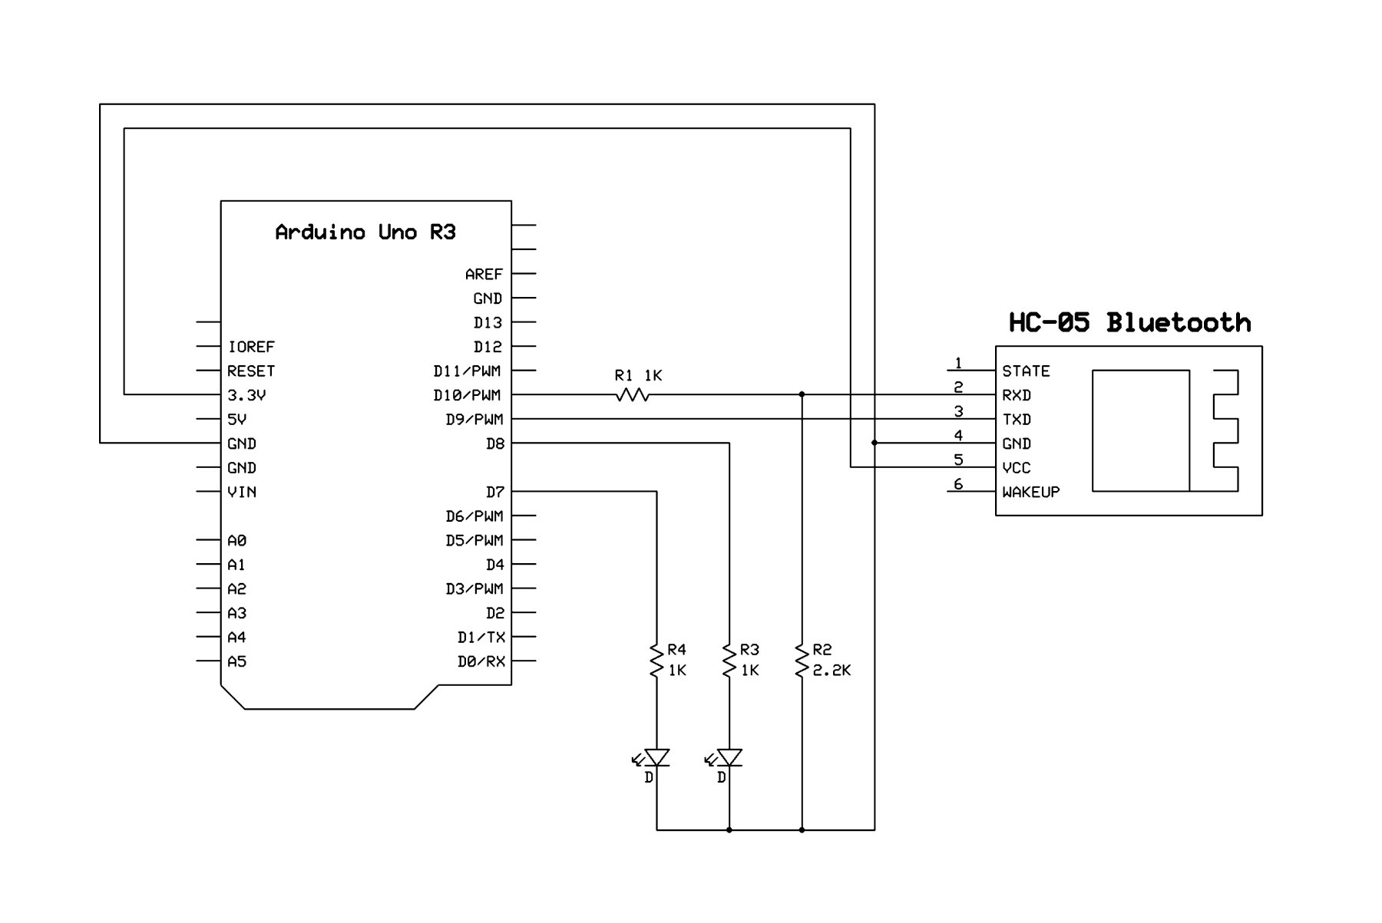
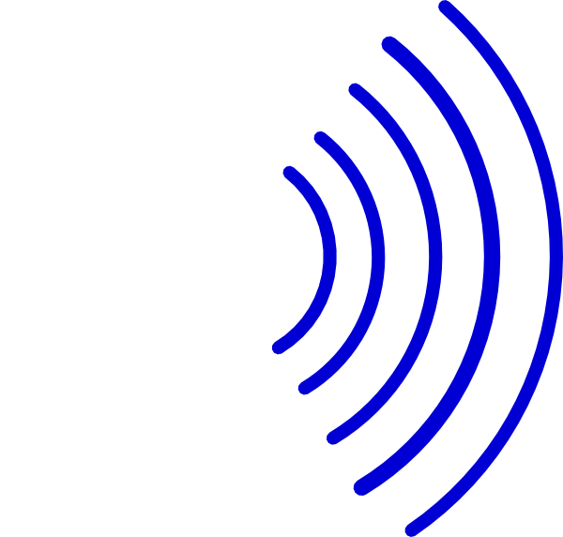
RFCOMM profile
HC-05 is an inexpensive Bluetooth-UART module
Has a UART interface for serial communication between the Bluetooth module and microprocessors
Bluetooth interface for wireless communication between two Bluetooth modules
2.4 GHz radio

Slide 19
Bluetooth Libraries

Slide 20
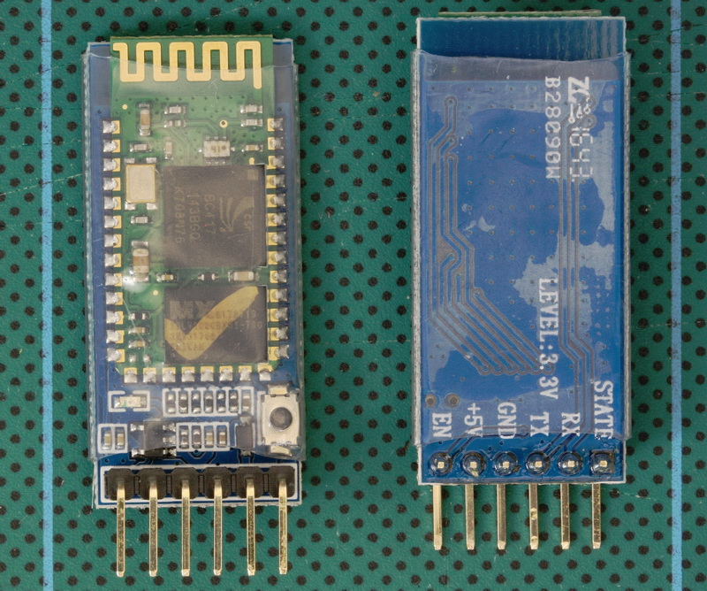
HC-05
In lab you will be working with the HC-05 Bluetooth Module
Implements Bluetooth wireless protocol
2.4GHz ISM (industrial, scientific, medical)
Short range, ~10 meters
Capable of communicating with:
Other HC05s
Cell phones
Most Bluetooth devices

Slide 21
Download Application
To communicate with your HC05 you will need to download an app.
Apps available for Android and iPhone
Once app is downloaded, you will need to pair with HC05 device before attempting to communicate.
App may ask for passcode, 1234

Slide 22
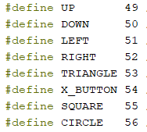
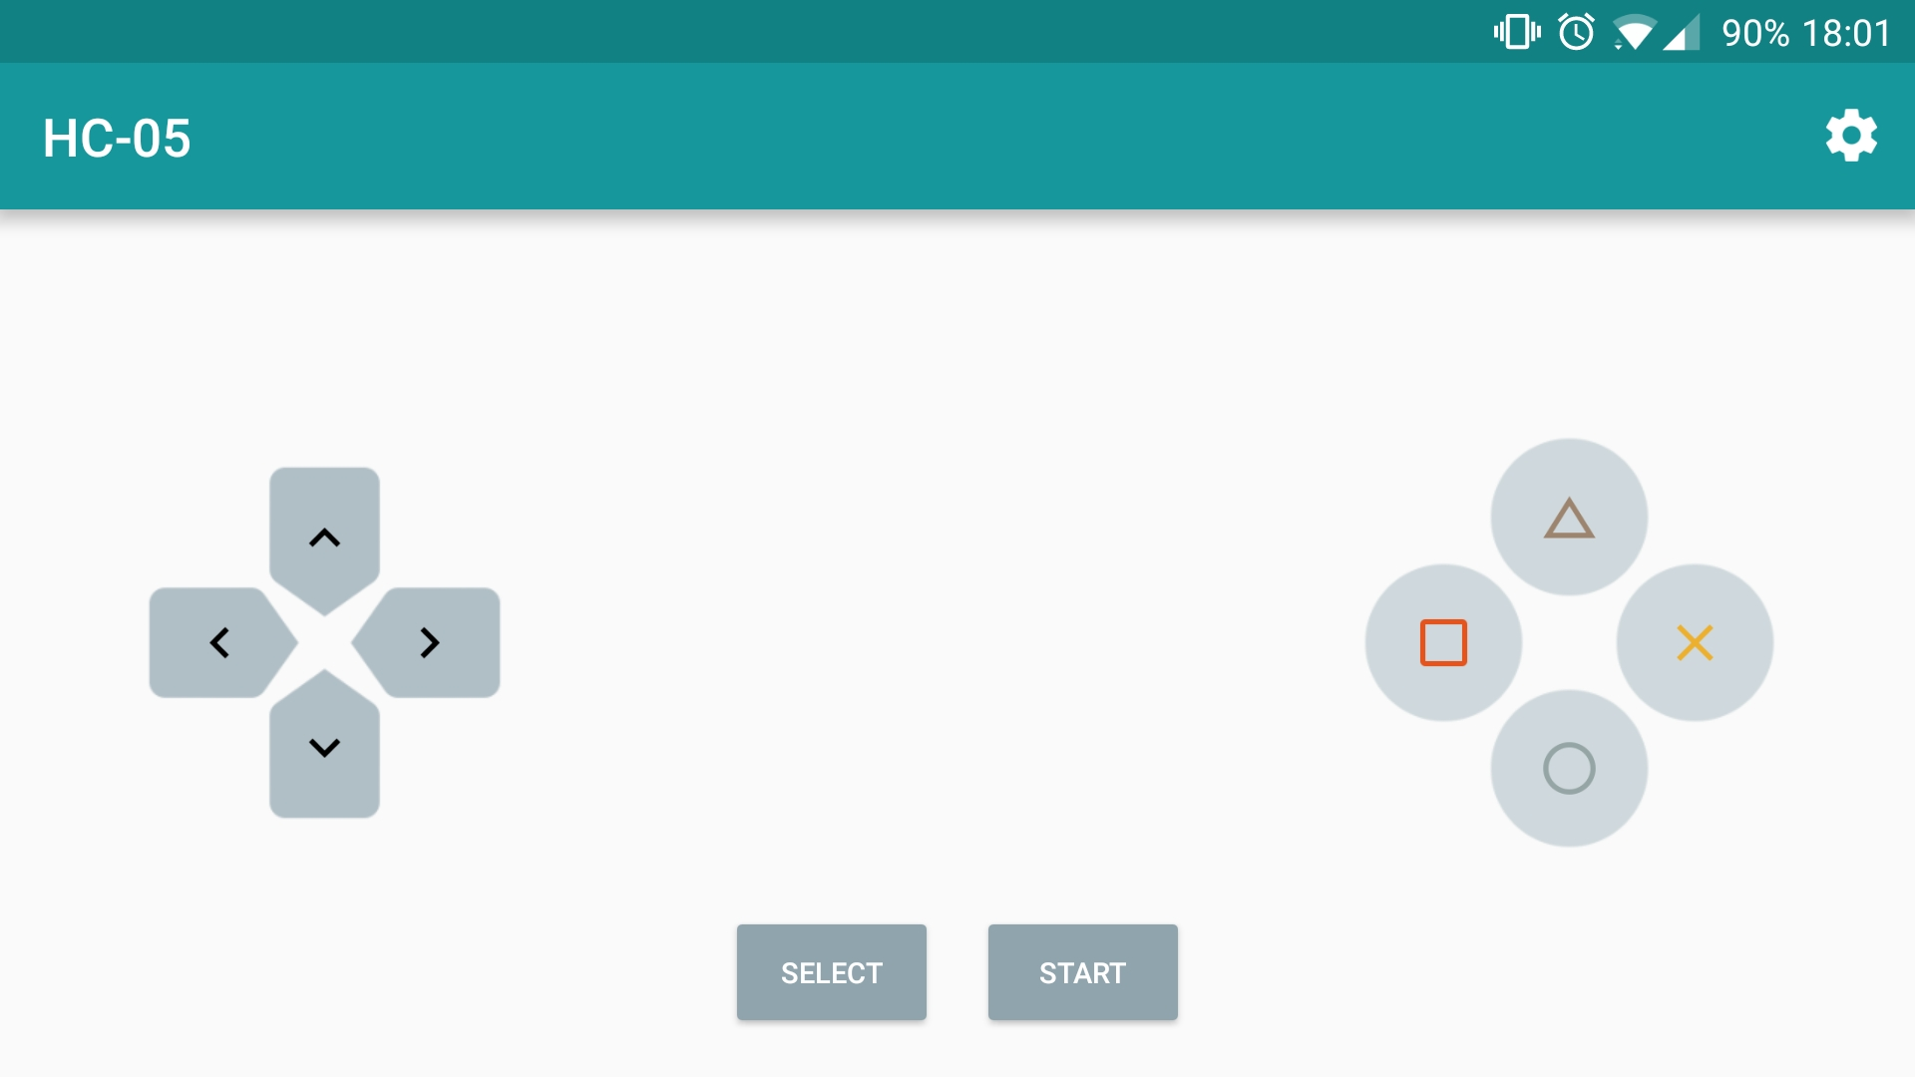
Keys and Codes
Each button press results in a transmitted value
Print each key value to the serial monitor
Determine which code represents which key
Assign helpful names to each code value (ASCII)

Slide 23
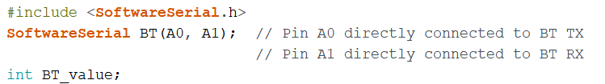
Software Serial library
In lab we will be working with the Software Serial library. The header file below must be included.
#include <SoftwareSerial.h>
Assign transmit and receive pins
Create storage variable BT_value

Slide 24
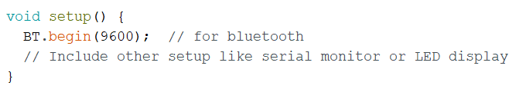
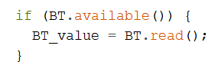
Setup to use Library
BT baud rate should be setup for 9600
To read if Bluetooth value is available:

Slide 25
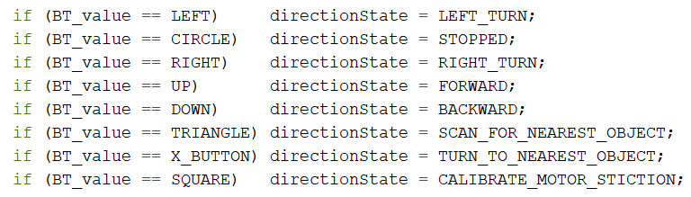
Create Function to Decode Key Codes
Use the received BT_value to change the directionState of your state machine

